Slide 1

Prayer time

Slide 2
Prayer time
You probably wondered why we took this topic Since it is now the holy month of Ramadan and we decided to create a project about the "time of prayer" Namaz is the duty of every Muslim, Namaz is recited 5 times a day
Fajr (Morning Prayer)
Zuhar (Midday Prayer)
Asar (Afternoon Prayer)
Maghreb (Evening Prayer)
Isha (Night Prayer)
And our application "Prayer Times" will be useful to many, as you can determine the time of prayer from anywhere in the world.
Our application "Prayer Time" is useful for those who keep fasting ramadan and read namaz

Slide 3
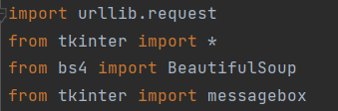
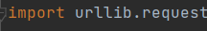
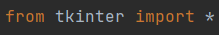
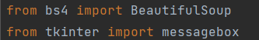
Library
URLLIB.REQUEST - is a Python module that can be used to open URLs.
TKINTER – is a Python package for working with the Tk library
We need to import libraries like a: tkinter,BeautifulSoup,request
BS4 – it is a Python library for extracting data from HTML and XML files
MESSAGEBOX – to create message box

Slide 4
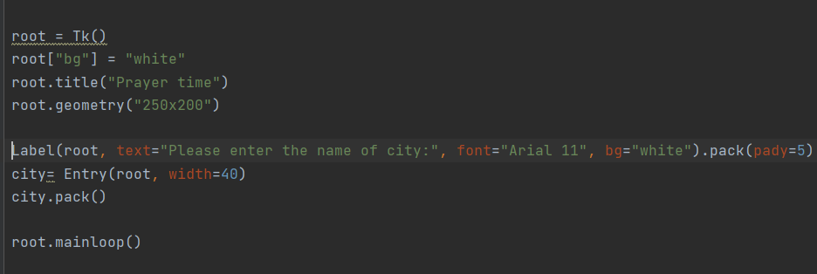
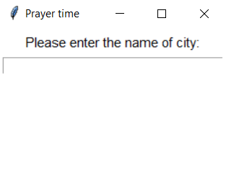
Application interface
our applicaion
First of all, create a window in which we will set its title, size and color.
To add text to our application, we will create and using the Label class, in this class we wrote the text, chose the font, color and position. Then created a window where we will write the name of the city
The last line calls the mainloop function. This function causes the window to endlessly loop, so the window will wait for any user interaction until it is closed.

Slide 5
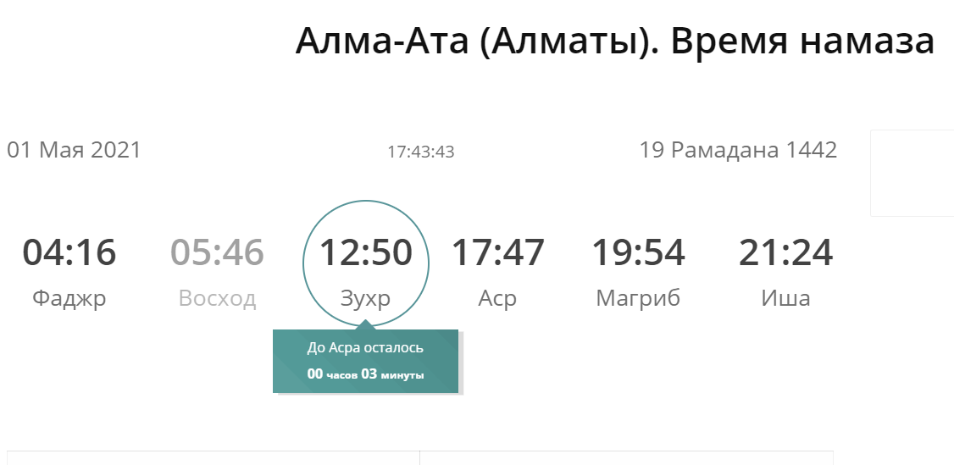

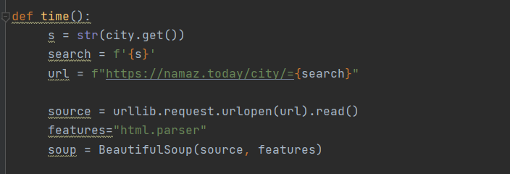
Parsing
For parsing, we took the site
“NamazToday”, on this site we see 5 times of prayer.
We will consider the details of parsing.
Firstly, we created function def time() .
When we write the name of the city and the name of the city changes instead of the word”search”
Indicated our url, url it is our link to site when we will get info
Сreated a variable soup and a BeautifulSoup class, the first parameter is “Source” where it will open our url and read all the data, the second parameter set the name of the parser that will be used, the name of our parser is "html.parser"

Slide 6
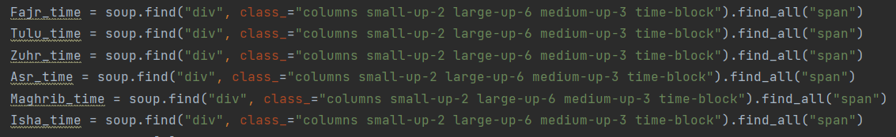
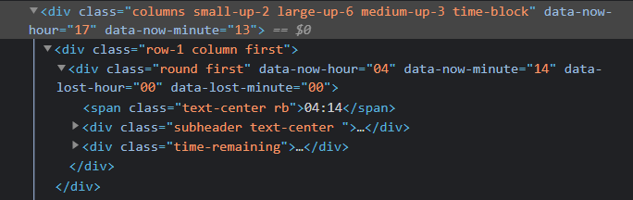
Parsing
In function def time()
We take the data about time for each prayer time, as we see all our data is saved in tag “div” class “columns small-up-2...”. And our data about time is saved in the tag “span” class “text-center rb” Then we have indicated to find all data with the tag “span”, in tag “div” class “columns small-up-2...”.

Slide 7
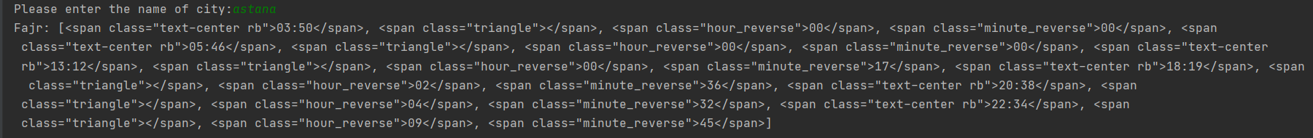
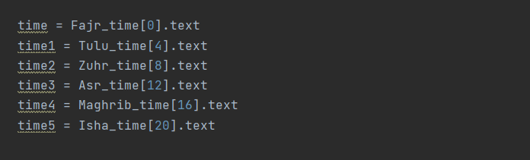
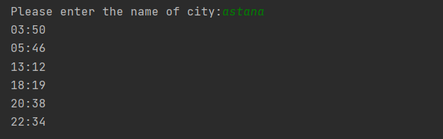
Parsing
If we run our program, then we will receive all our data with the tag span
As we can see, here we have all our data about the time. To get them, we indicated the index for each and write “.text” to get only the text
After that we got only time

Slide 8
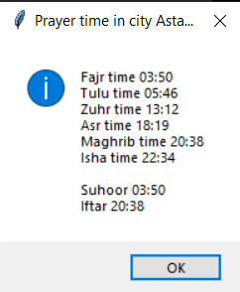
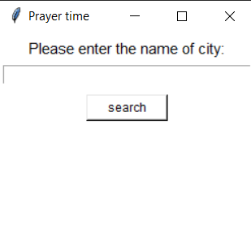
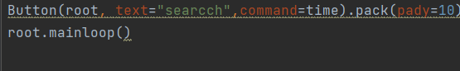
3.Parsing
After that we get message box
messagebox.showinfo("Prayer time in city "+ s," Fajr time " + time +'\n'+ " Tulu time " + time1 +'\n'+ " Zuhr time " + time2 +'\n'+ " Asr time " + time3 +'\n'+ " Maghrib time " + time4 +'\n'+ " Isha time " + time5+'\n'+ "" +'\n'+" Suhoor " + time +'\n'+" Iftar " + time4)
To show the message box with Tkinter used messagebox
Create a button with Button class, in this class we wrote the text, and call function time, when we press the button

Slide 9
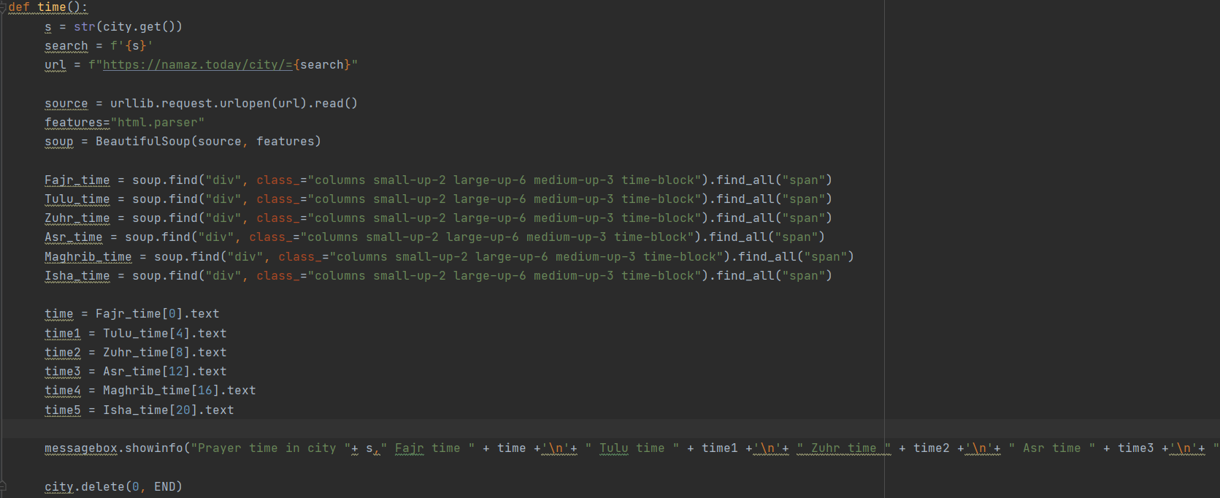
Function “time”

Slide 10
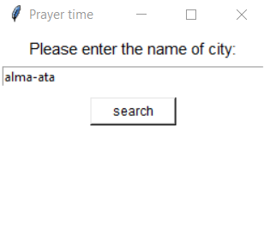
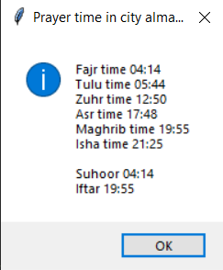
Total
When we run all the code and the interface exits, we enter any country in which we want to find out the prayer
And we get the exact time of prayer, with Iftar and Subhoor

Slide 11

Thanks for attention
In this project, we used materials from the lessons learned.
We used the site for parsing:
https://namaz.today
To create an application, we studied from the site:
https://pythonru.com/uroki/obuchenie-python-gui-uroki-po-tkinter
The project was made by:
Sanzhar Kalmakhan
Seidaliev Shyngyskhan

